Slide 1

Evaluating Customer Behavior Using Regression, Classification, and Clustering Models
Data-Driven Approach to Understanding Customer Dynamics

Slide 2

Introduction
This project investigates data from the Classic Models database to discover insights into customer behavior, sales trends, and employee performance in a classic car dealership. These insights are meant to provide an optimal approach toward marketing strategy, sales improvements, and support better business decisions using SQL Databases, Analytics, and Marketing Analytics techniques.

Slide 3
Objective
To analyze customer behavior and sales trends using advanced data analytics techniques.

Slide 4
Research Question
How do customer demographics and marketing campaign strategies influence purchasing behavior and sales trends at the classic car dealership?
Null Hypothesis (H₀): There is no significant influence of customer demographics and marketing campaign strategies on purchasing behavior and sales trend in classic car dealerships.
Alternative Hypothesis (H₁): Customer demographics and marketing campaign strategies significantly influence purchasing behavior and sales trends at the classic car dealership.

Slide 5
Research Question
How does customer behavior/sales trend in the classic car dealership support the optimization of marketing strategies for further improving sales performance?
Null Hypothesis (H₀): Customer behavior and sales trends do not provide meaningful insights for optimizing marketing strategies to improve sales performance.
Alternative Hypothesis (H₁): Customer behavior and sales trends provide meaningful insights for the optimization of marketing strategies in improving sales performance.

Slide 6
Dataset Overview
Source: Classic Models database.
Key Attributes:
Customer demographics.
Sales metrics (total purchases, purchase frequency).
Employee performance metrics.

Slide 7
Methodology
Techniques Used:
Regression analysis for identifying the drivers of sales
Classification for predicting customer behavior
Clustering for customer segmentation
Tools: SQL and Python.
Process: Data preprocessing → Modeling → Evaluation

Slide 8
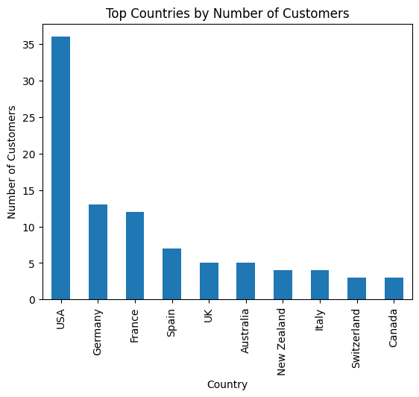
Data Visualization
Customer Demographics: Sales By Region
Finding: Countries USA, Germany, and France have the most customers, with higher average credit limits in Country USA.
Insight: Focus marketing campaigns on Country USA to target high-value customers.

Slide 9
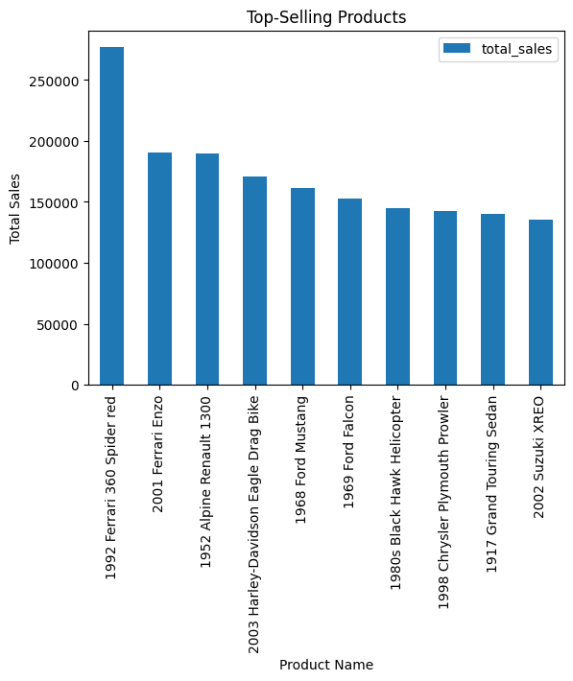
Data Visualization
Product Sales Trends: Top Selling Products
Finding: Product 1992 Ferrari 360 Spider red, 1992 Ferrari 360 Spider red, and 1992 Ferrari 360 Spider red contribute the most to revenue.
Insight: Increase stock and promotions for these products to maximize sales.

Slide 10
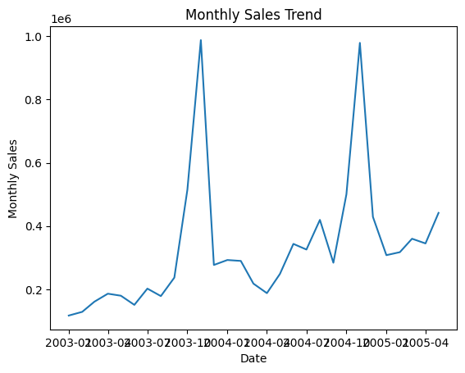
Data Visualization
Order Details: Order Trends
Finding: Sales peak in months like June and December.
Insight: Launch targeted promotions before these months to capitalize on seasonal demand.

Slide 11
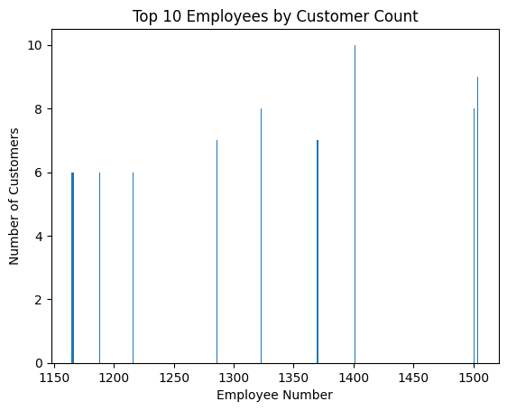
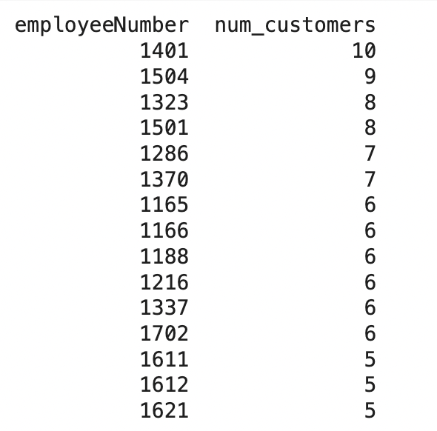
Marketing Campaigns: Customer distribution by employee, city and job title. Insight: Employees with higher workloads may be supported, or their performance can be studied to optimize the assignment process.

Slide 12
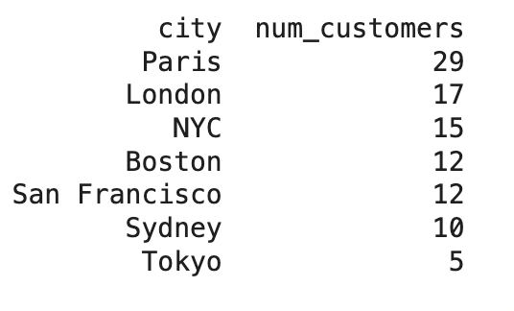
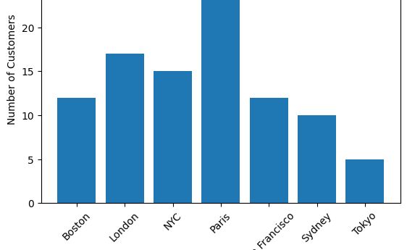
Insight: If an office is far away from cities that have high customer density, opening a new office or reallocation of resources may bring more effectiveness in marketing.

Slide 13
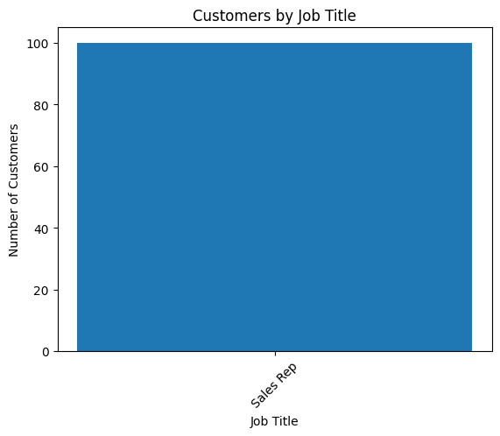
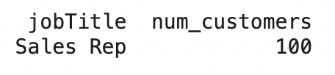
Insight: If there are certain types of roles that regularly have more customers, this may drive training and hiring.

Slide 14
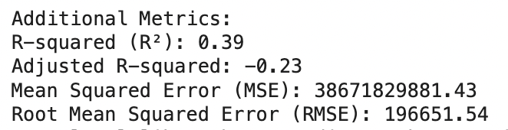
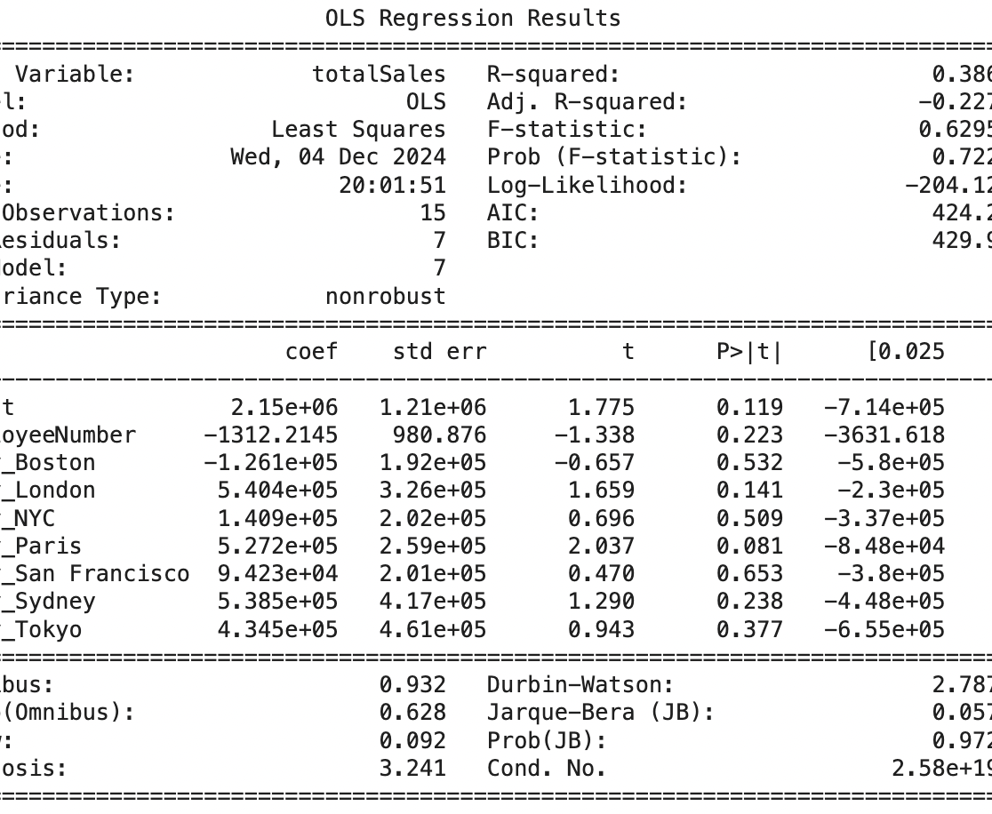
Regression Analysis
Objective: Determine which factors affect total sales.
Key Findings:
R-squared: 0.39 (39% variation explained by the model).
Employee number shared a small negative correlation with sales.
No significant contribution from city-specific variables.
cities, had p-values > 0.05, indicating they are not statistically significant to predict totalSales. This therefore supports the null hypothesis, which states there is no significant relationship between predictors and the target variable.

Slide 15
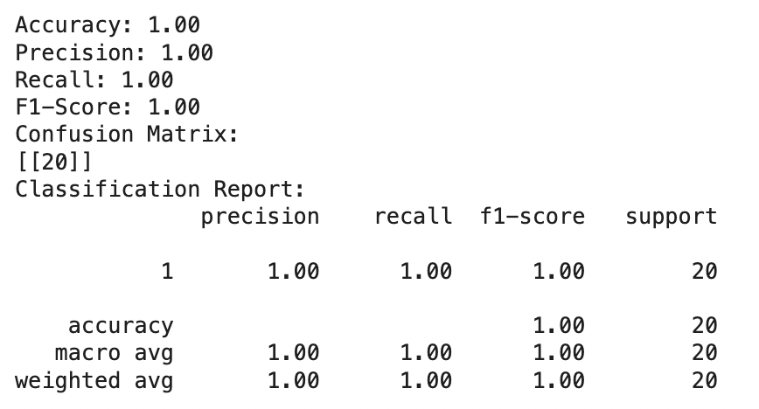
Classification
Objective: Predict high-value customers.
Results:
Precision, recall, and F1-score: 1.00.
High accuracy indicates great performance of the model.
The accuracy, precision, recall, and F1-scores were perfect at 1.00, suggesting an excellent model performance. This agrees with the alternative hypothesis that indeed, the classification model performs well in predicting the outcomes from the given data.

Slide 16
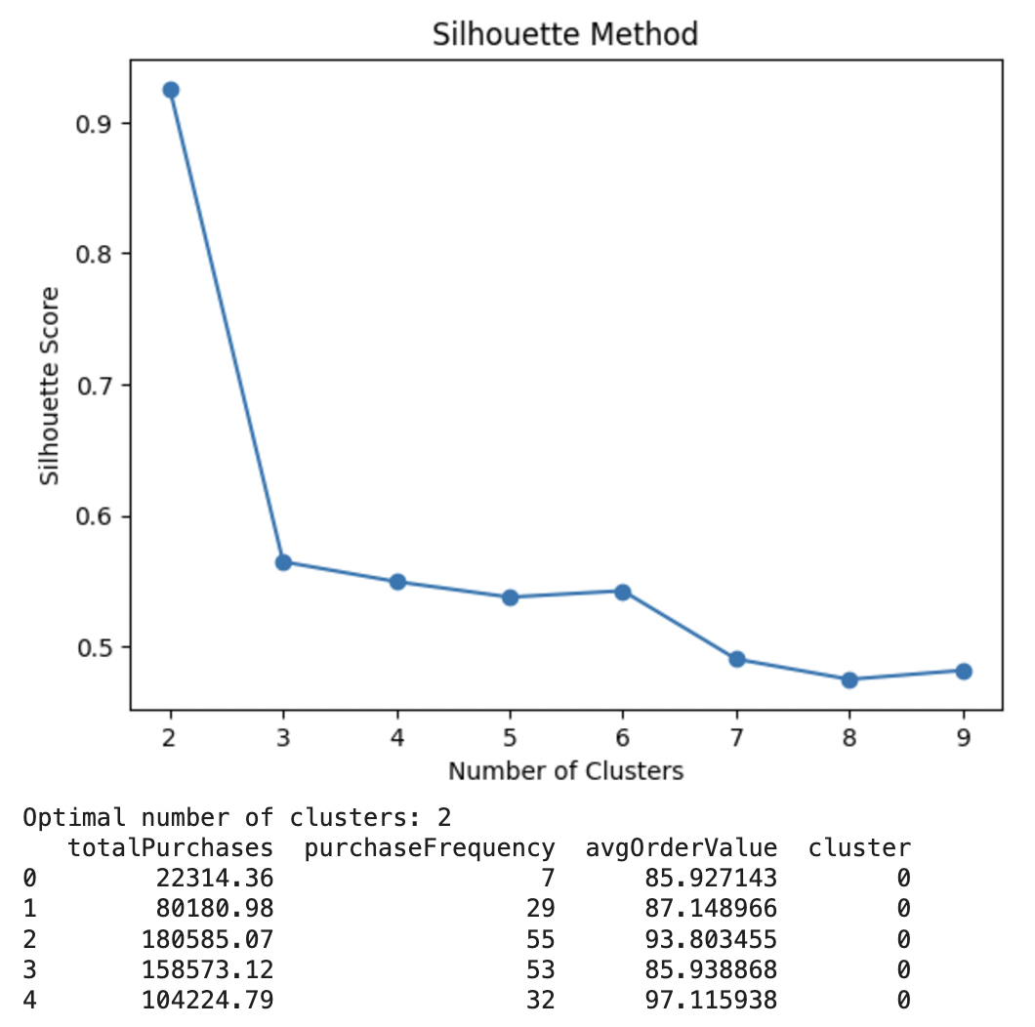
Clustering
Objective: Segmenting Customers Based on Purchasing Patterns
Key insights:
Optimal clusters: 2
Silhouette score: 0.93 - strong clustering
Cluster characteristics: high vs. low purchase frequency groups.
The Silhouette Score of 0.93 reflects very strong clustering, which would support the alternative hypothesis, meaning that the clustering identified some meaningful groups within the data.

Slide 17
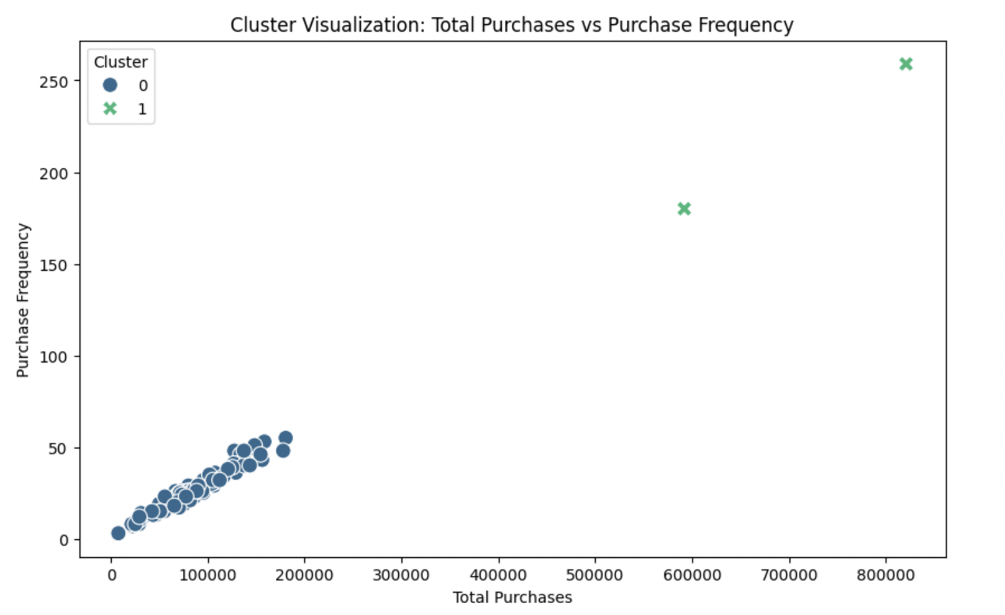
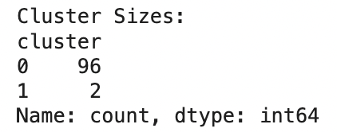
Cluster Visualization
Summary Statistics:

Slide 18
Key Insights
Regression produced very few predictors of sales.
Classification effectively identified the high-value customers.
Clustering found meaningful segments of customers.
Overall: Data-driven marketing and operational decisions can benefit.

Slide 19
Strengths and Limitations
Strengths: Extensive data analysis was done. Very accurate classification and clustering. Limitation: Small sample size limits generalizability Multicollinearity in regression reduces reliability

Slide 20
Implications
Targeting Marketing for High-Value Customers
Fine-tune the sales strategies based on segmentation of customers
Pinpoint employee performance gaps and improve on them

Slide 21
Conclusion
This research will showcase the insight into customer behavior and provide enhanced business strategy for the classic car dealership using some data analytics methodologies like regression, classification, and clustering. The models identified interesting patterns; however, there are some limitations related to small datasets and some overlapped data. In general, this analysis provides support to better decisions and enhancements of businesses.

Slide 22
Thank You for your attention
Any Questions ?

